Slide 1


Slide 2
Topics Covered
Ansible Tower explained
Look and feel of Dashboard
Real-time job status
Multi Playbook workflow

Slide 3
Ansible Tower explained
With Red Hat® Ansible® Tower you can centralize and control your IT infrastructure with a visual dashboard.
You can schedule your jobs, integrate notifications.
Easy to manage your inventory in Graphical manner.
Atmost advantage of tower is you can manage your infrastructure in single click of button.
Also it can be easily embed into existing tools and processes with REST API and CLI.

Slide 4
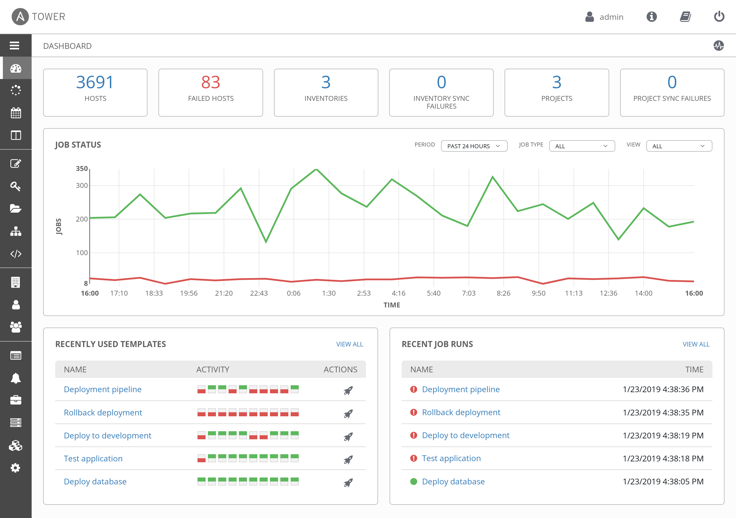
Look and feel of Dashboard

Slide 5
Dashboard Explained
As soon as you log in, you'll see your host and inventory status.
All the recent job activity triggered.
Graphical representation of specific job and time ranges of triggered.
It also gives you the clear visibility of failed and success jobs.

Slide 6
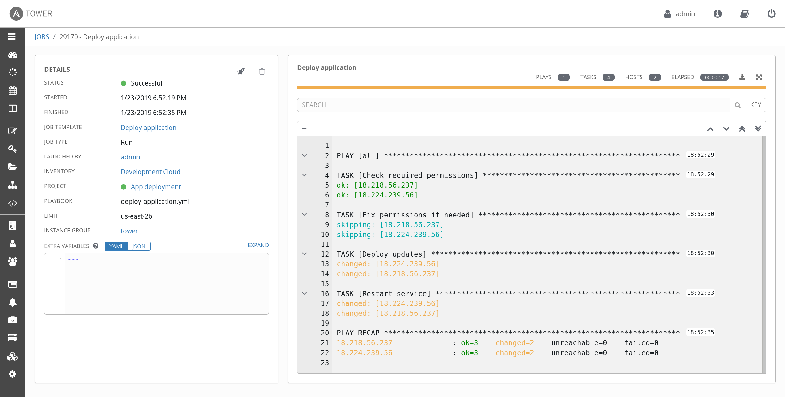
Real-time job status

Slide 7
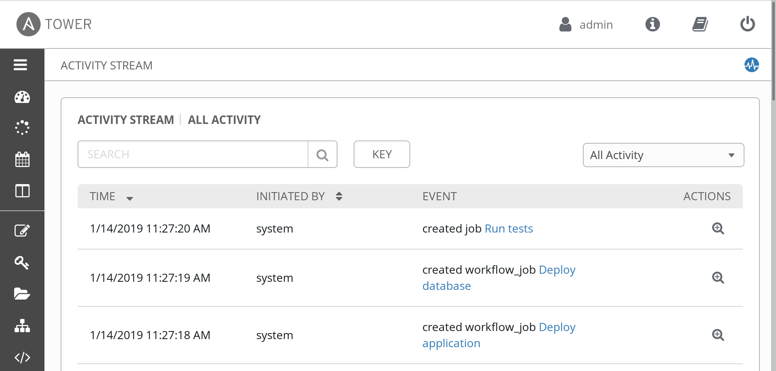
Who Ran what Job when ?

Slide 8
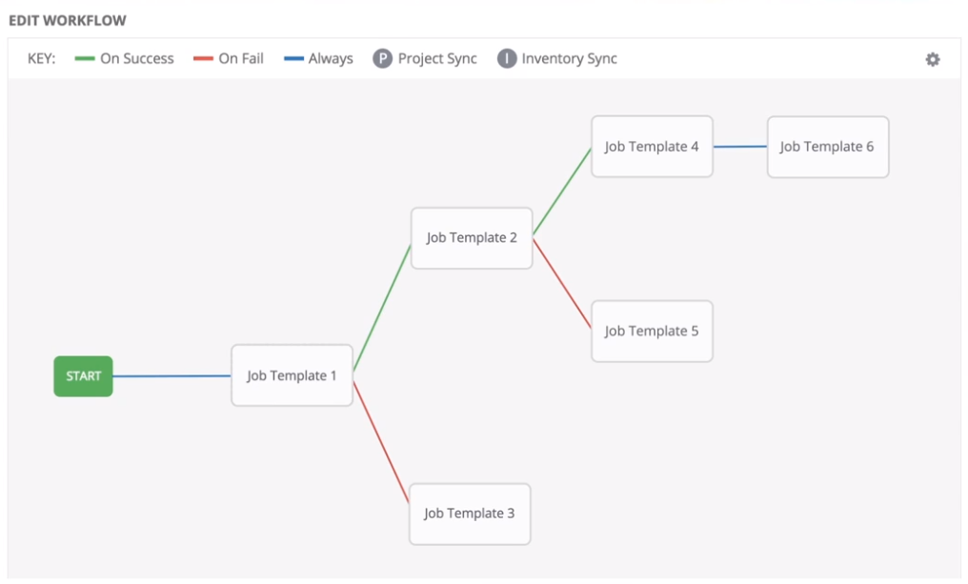
Multi Playbook workflow
You can also drag and drop you playbook and set an orchestration workflow.

Slide 9
End…

